Slide 1


SkillsBuild For CollegeS
Orientation

Slide 2




Edunet Foundation
Goal
Creation of educational networks and sustainable
communities
Audience
150,000+ learners in past 12 months from K-12 schools, ITIs and colleges
Registered Trust
Recognized under sections 12AA and 80G of Income Tax Act.
Focus
4th & 5th Industrial Revolution focused Employability and
Entrepreneurship
More than 300,000+ Higher Education learners
GuideStar Verified
for transparency
National Footprint
Large pool of technical manpower on the ground: 70+ technical and soft-skills trainers
Over 250 active institution partnerships and access to tens of thousands of students
Special Consultative Status
with the United Nations
Great Place To Work Certified
Notes:
The Platform and

Slide 3
Why this Program?
Current Job Market: The job market is experiencing an increasing demand for technical skills, driven by rapid advancements in technology. IBM SkillsBuild for College equips students with the necessary expertise to meet these demands and thrive in the digital age
An estimated 85 million jobs may be displaced by automation by 2025 – “World Economic Forum”
Our programs are specifically designed to equip you with the essential digital skills and knowledge required by employers today
Preparation for the Digital Age: As technology becomes more integrated into every industry, it is crucial for students to be prepared for the digital age. IBM SkillsBuild for College ensures students are equipped with the latest industry-aligned skills, essential industry tools and knowledge to succeed in a technology-driven world
Industry-relevant projects that simulate the challenges and demands of the workplace. These projects enable you to demonstrate your skills, problem-solving abilities, and ability to deliver tangible results
Rewarding Career Opportunities: Industry-aligned skills are essential for students to secure rewarding career opportunities. The program provides hands-on experience using real world problem statements and practical knowledge in areas such as cloud computing, artificial intelligence, and machine learning, Data Analytics, and Cyber Security enhancing students' employability and opening doors to exciting career prospects

Slide 4

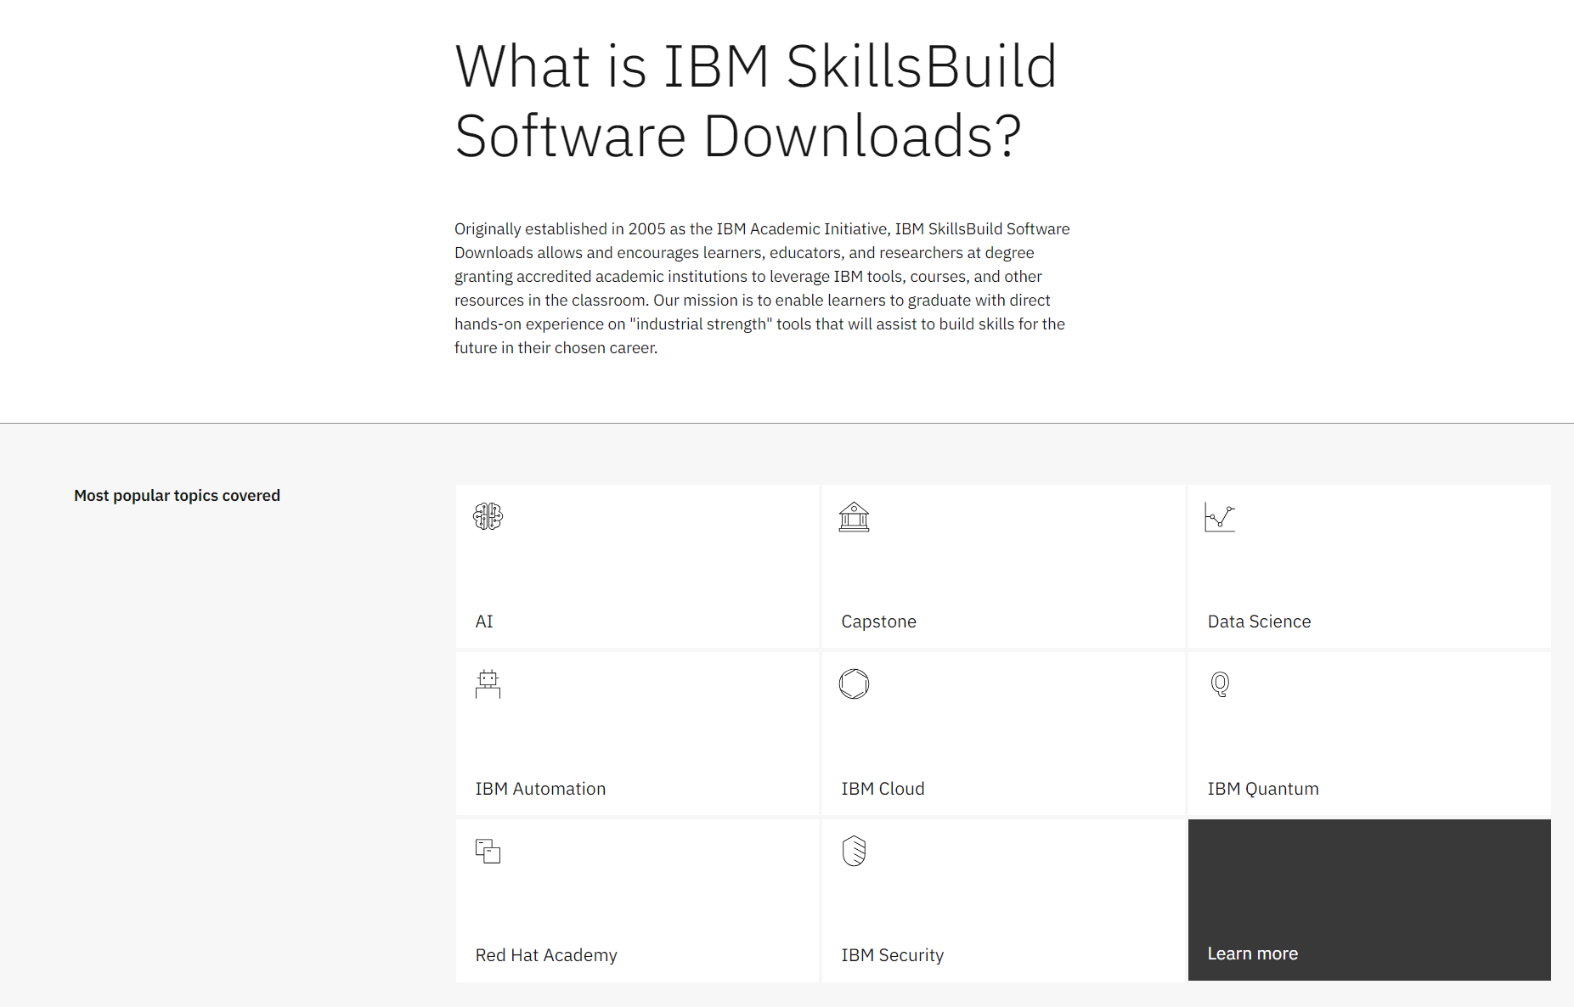
aims to provide students with essential technical skills and training to enhancetheir employability and prepare them for the industry. The program offers a range of online courses and resources designed to develop both technical with hands-on project experience as well as professional skills.
Key features of the SkillsBuild for College Program include:
Courseware: Access to courseware that offers the foundation for technology jobs of tomorrow, including emerging technologies, data science, cybersecurity, artificial intelligence and cloud computing
Access to IBM Cloud and Software: Enhanced access to the IBM Cloud and select cloud-based resources, applications, and software's used in present day jobs
Hands-on Projects: The program includes practical assignments and projects that enable students to apply their knowledge and gain hands-on experience in real-world scenarios.
Badges and Certifications: Upon successful completion of courses, students earn digital badges and certifications from IBM, validating their skills and accomplishment
https://www.ibm.com/academic/home
Notes:
The Platform and

Slide 5
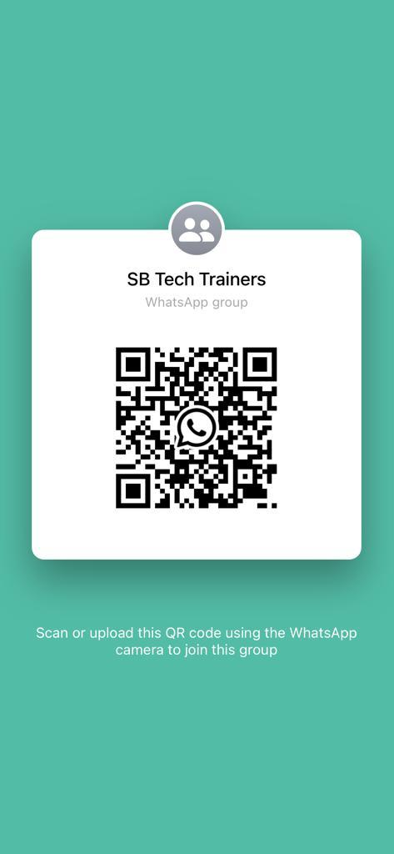
WhatsApp Group
Notes:
Change the QR Code as The Trainer will Create a Whatsapp Group. Keep the QR Code from there

Slide 6

Attendance Form
Notes:
https://forms.gle/dxBrm9MoanPP3oJL6
Trainers:
Trainers Should Get the Link from Program Team (Sami).
After getting the Form Link visit https://www.the-qrcode-generator.com/
Enter your URL generate QR Code. Paste that QR Code Over here.

Slide 7
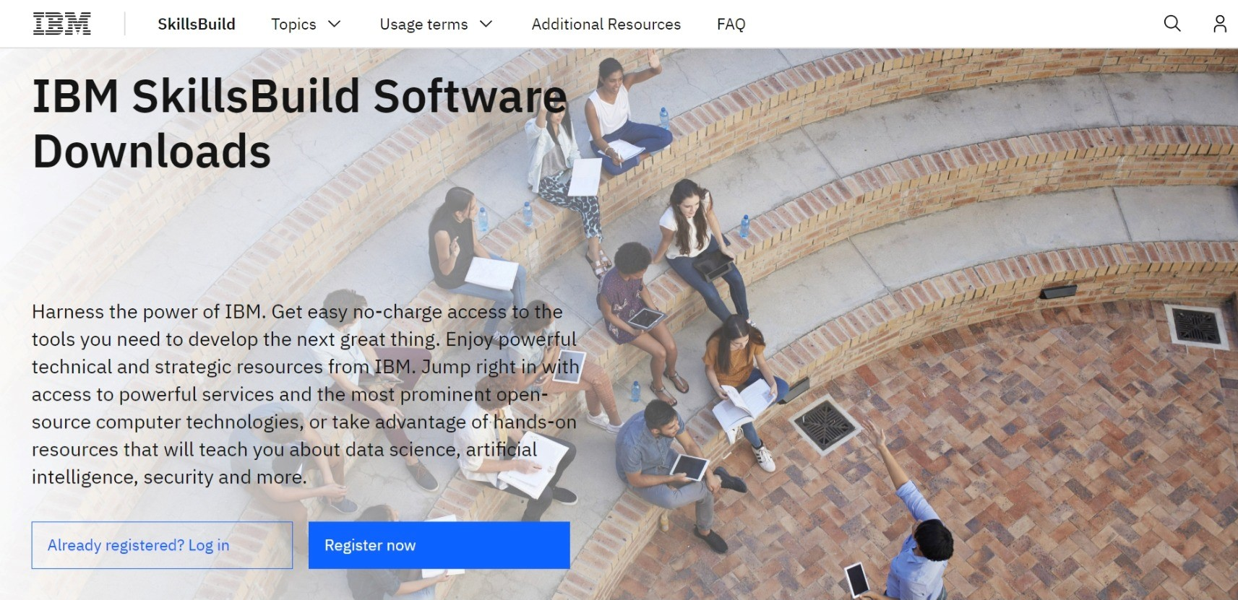
How to Register on IBM Skillsbuild Software Download Estimated time: 5 – 10 minutes

Slide 8
https://www.ibm.com/academic

Slide 9
Step 1: Open the IBM SkillsBuild Software Downloads website in a web browser

Slide 10

Step 2: Click “Register Now”

Slide 11
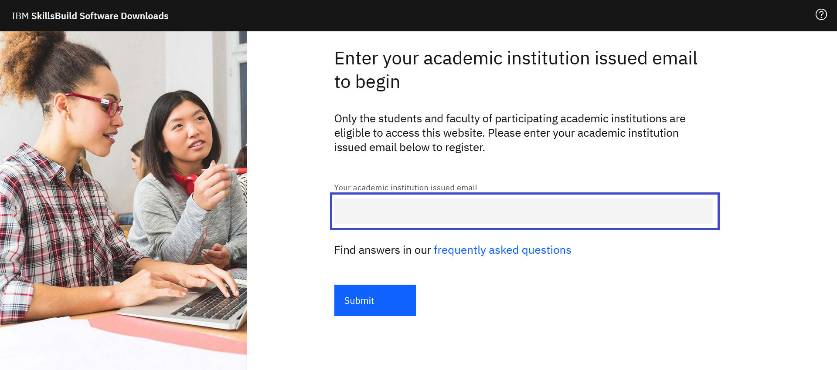
Step 3: Enter your academic institution, university, college issued email ID

Slide 12
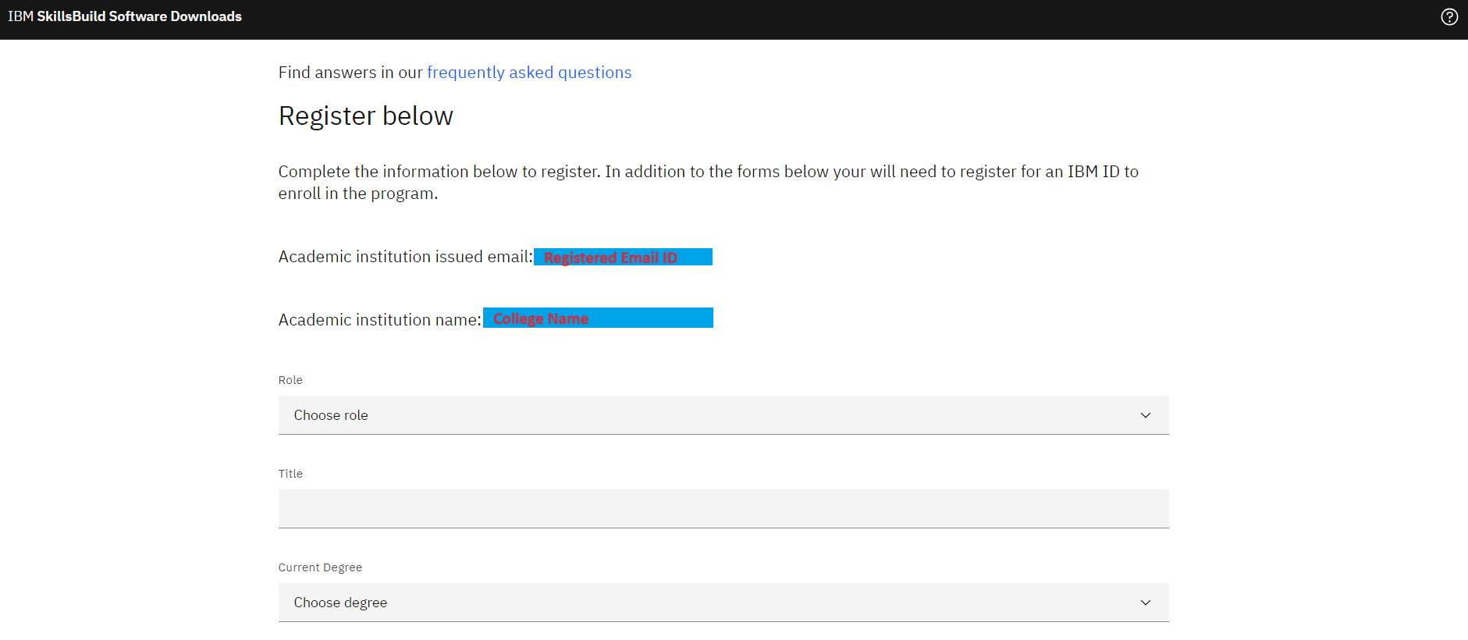
IF YOUR COLLEGE ID AND NAME DID NOT APPEAR THEN CROSS VERIFY YOUR MAIL ID ONE MORE TIME

Slide 13
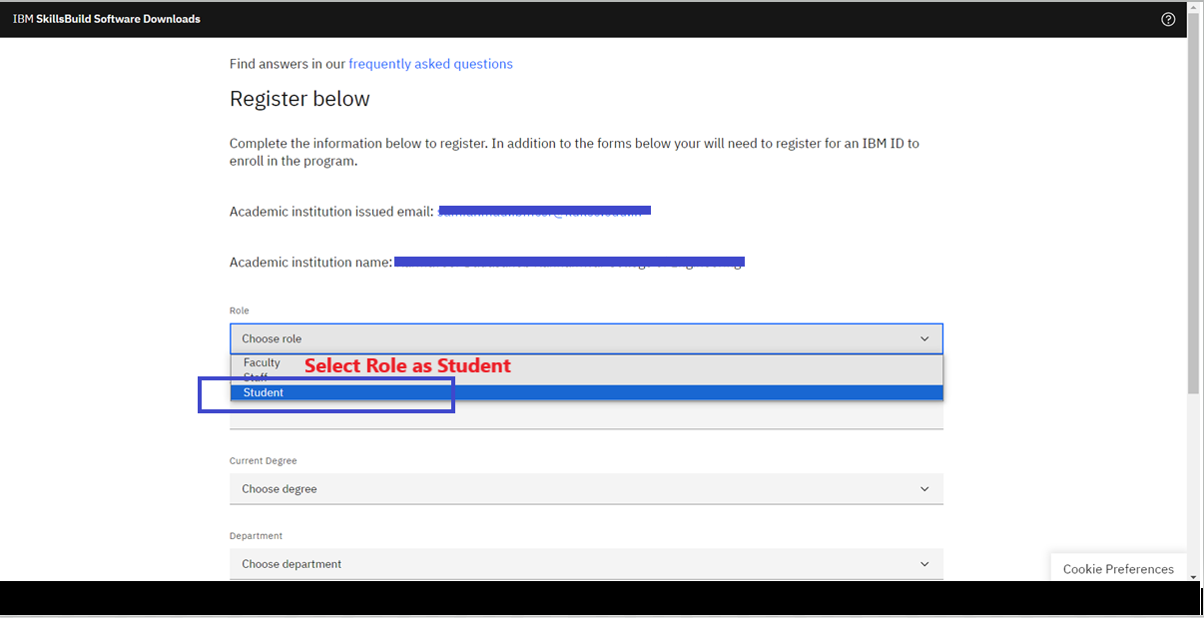

Slide 14
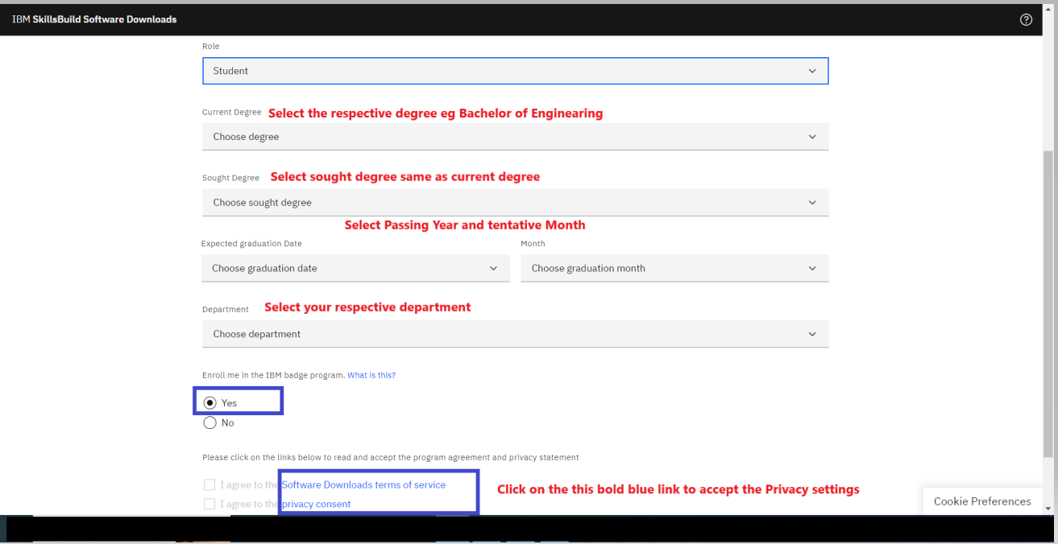

Slide 15
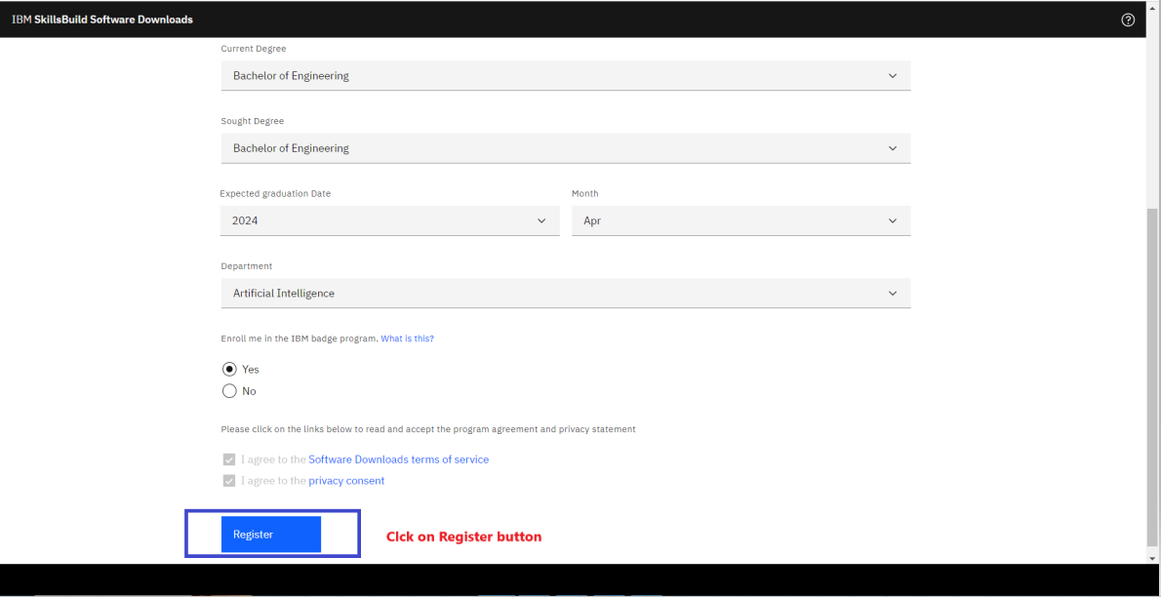

Slide 16
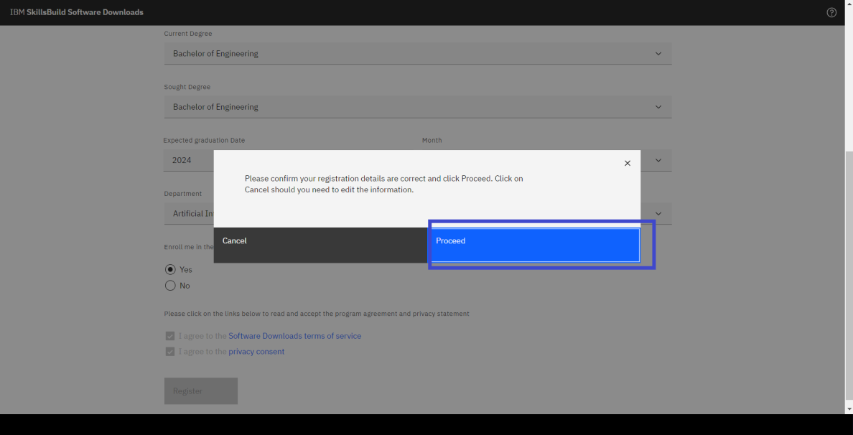

Slide 17
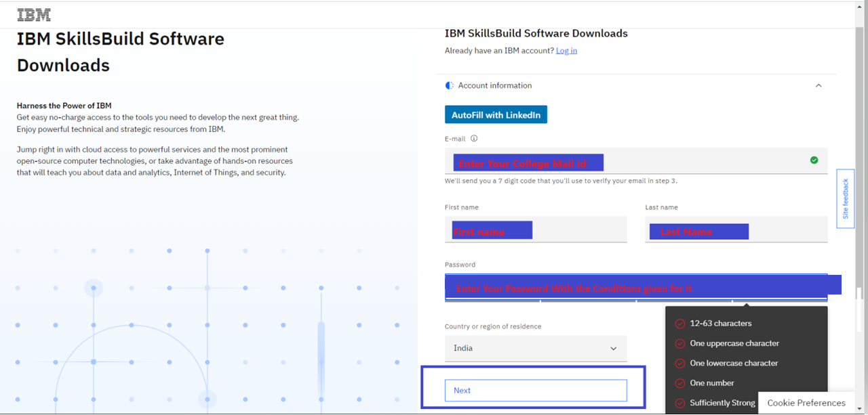

Slide 18
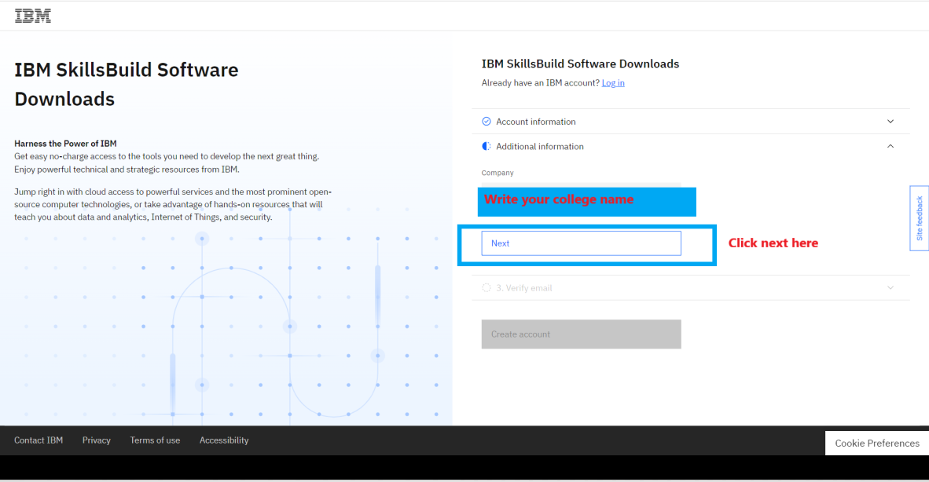

Slide 19
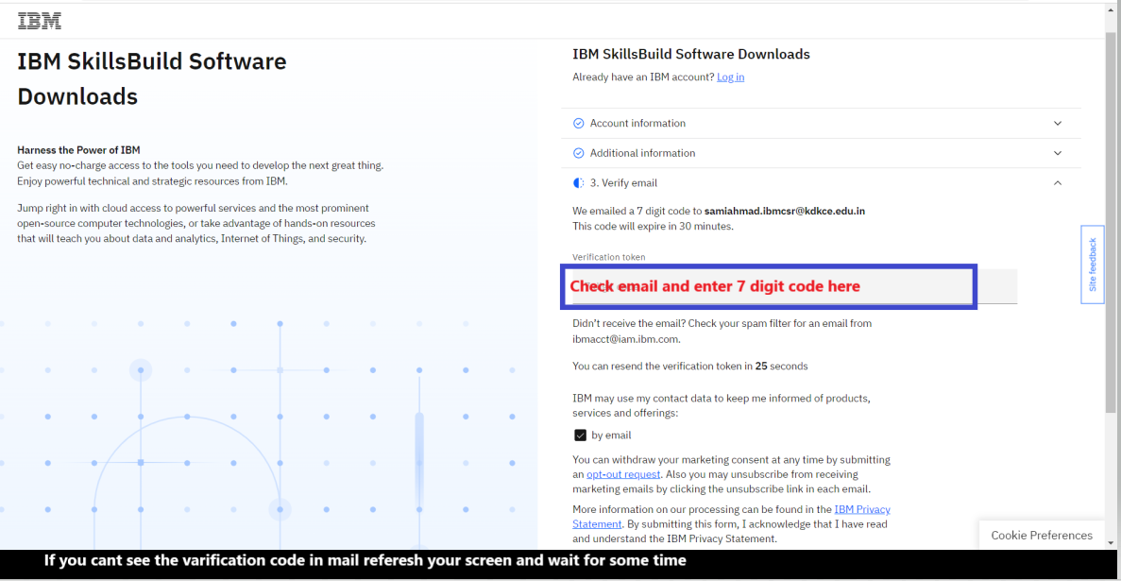

Slide 20
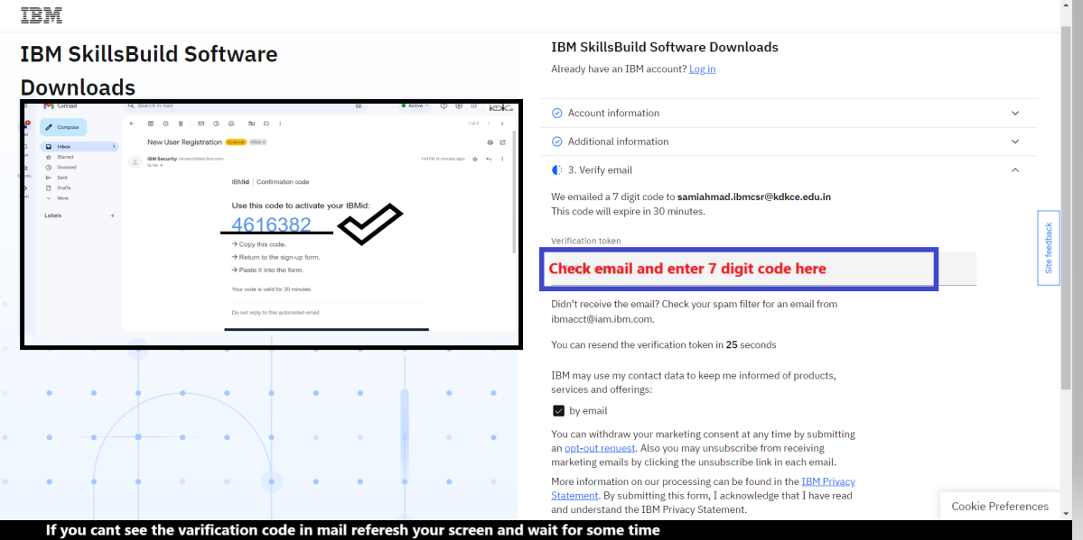

Slide 21
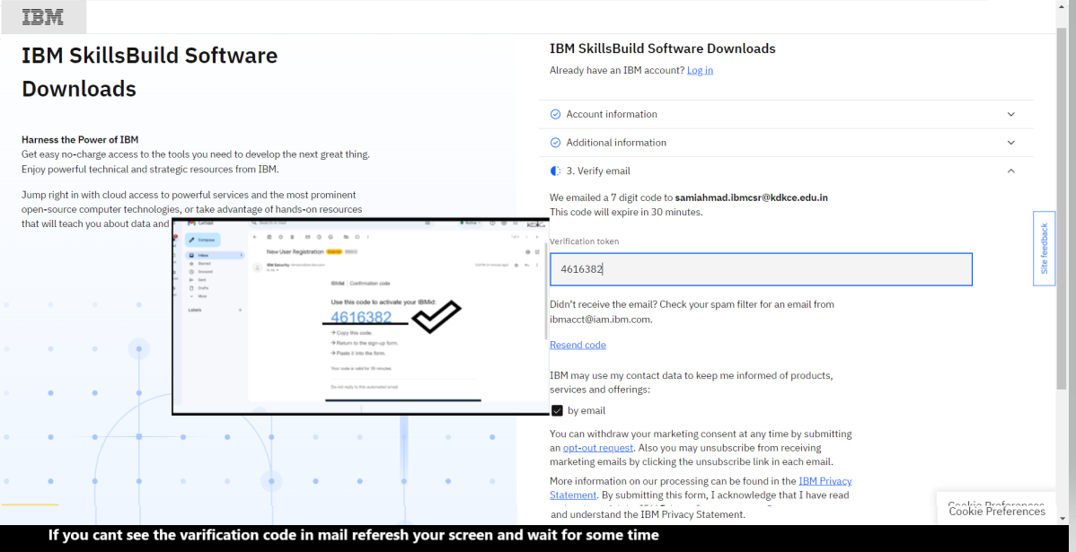

Slide 22
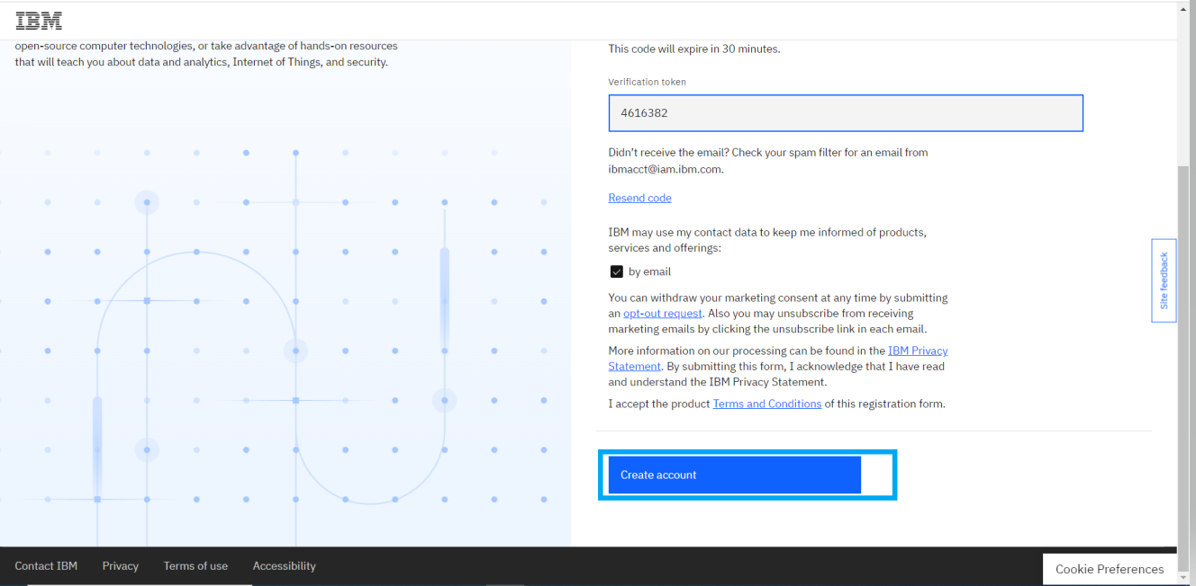

Slide 23
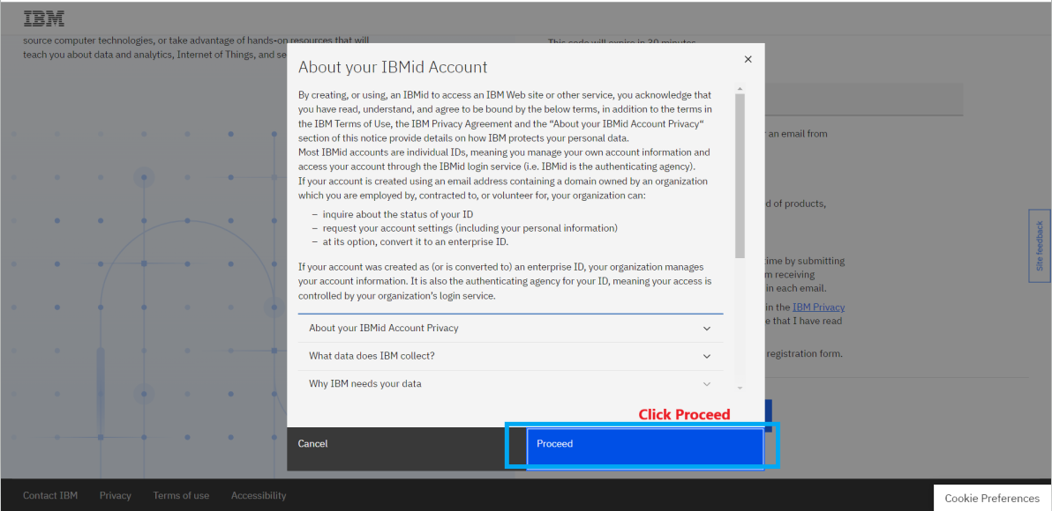

Slide 24
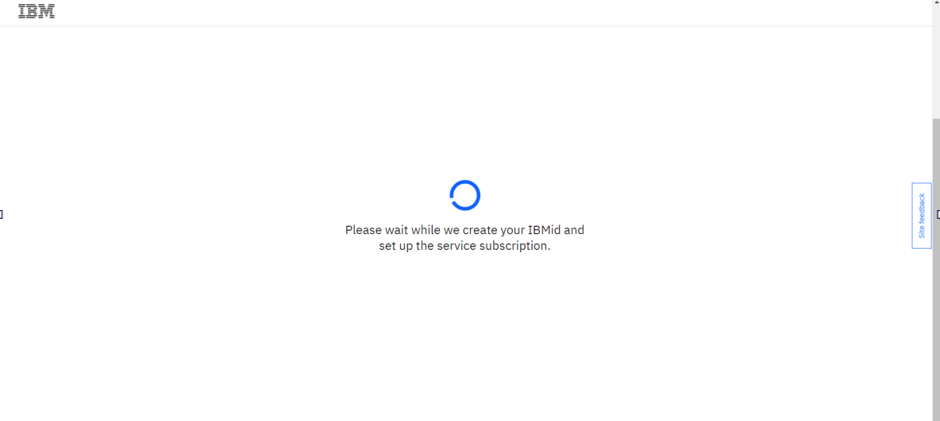

Slide 25
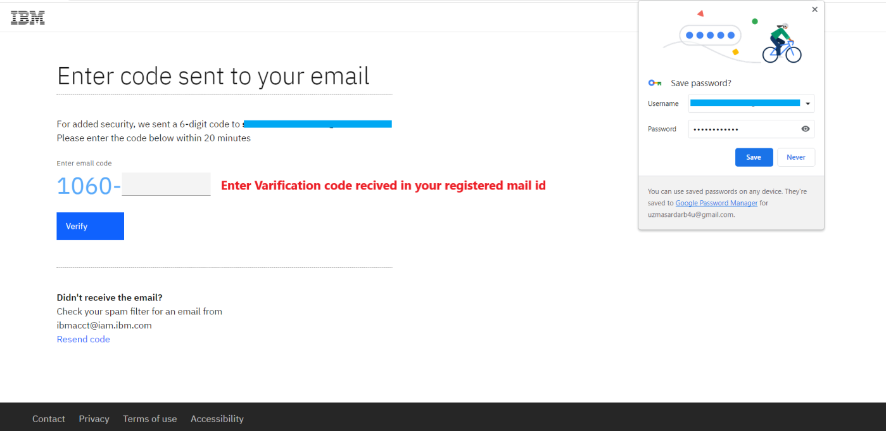

Slide 26
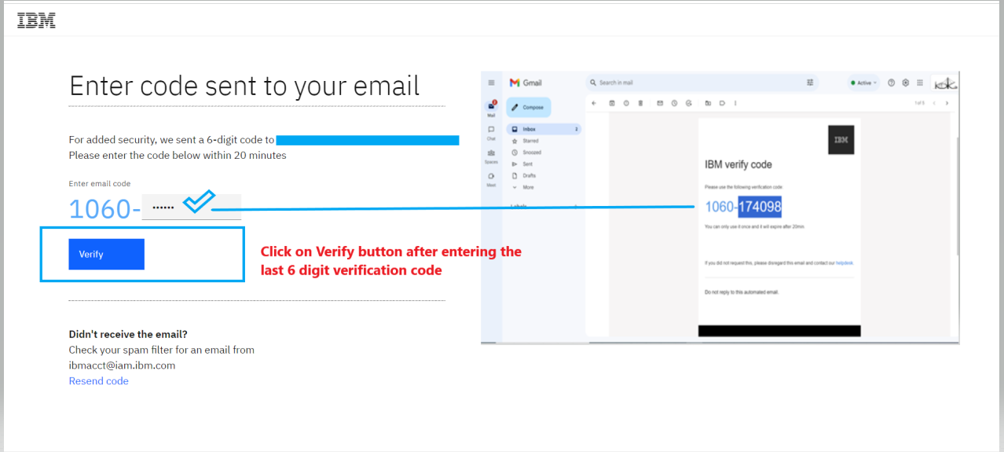

Slide 27
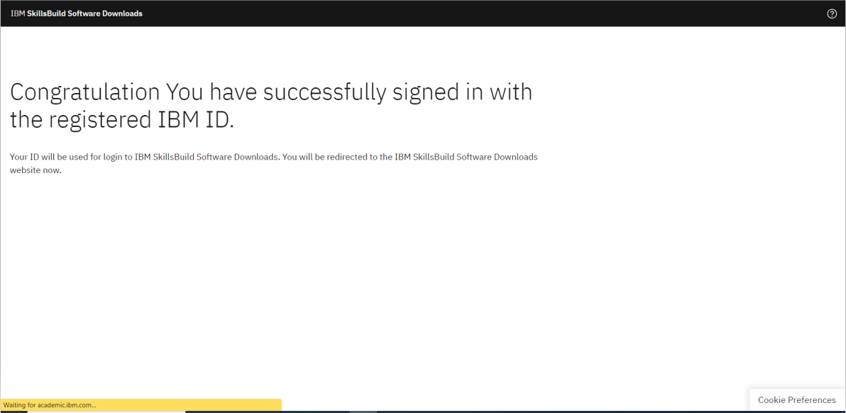

Slide 28
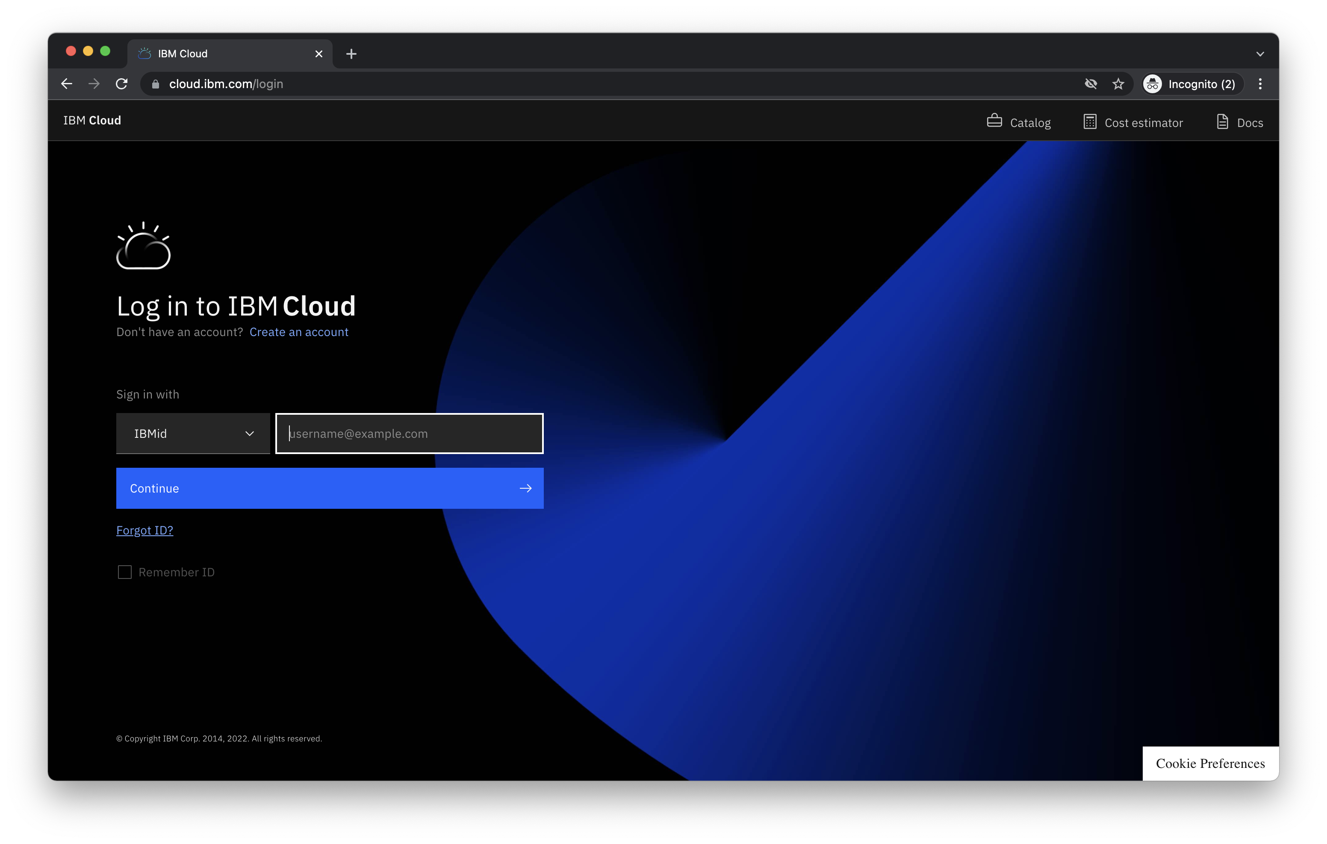
How to Do the Courses on IBM Academic Estimated time: 5 – 10 minutes

Slide 29


Slide 30
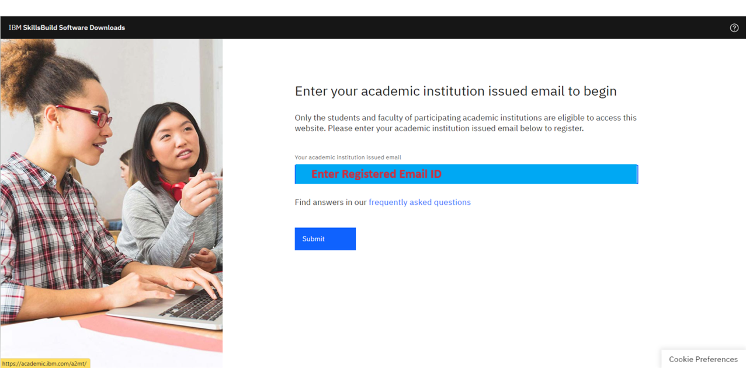

Slide 31
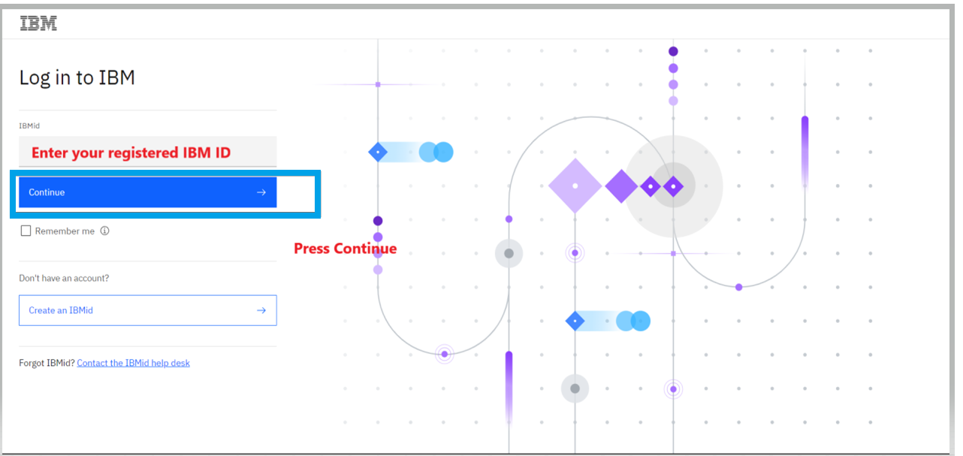

Slide 32
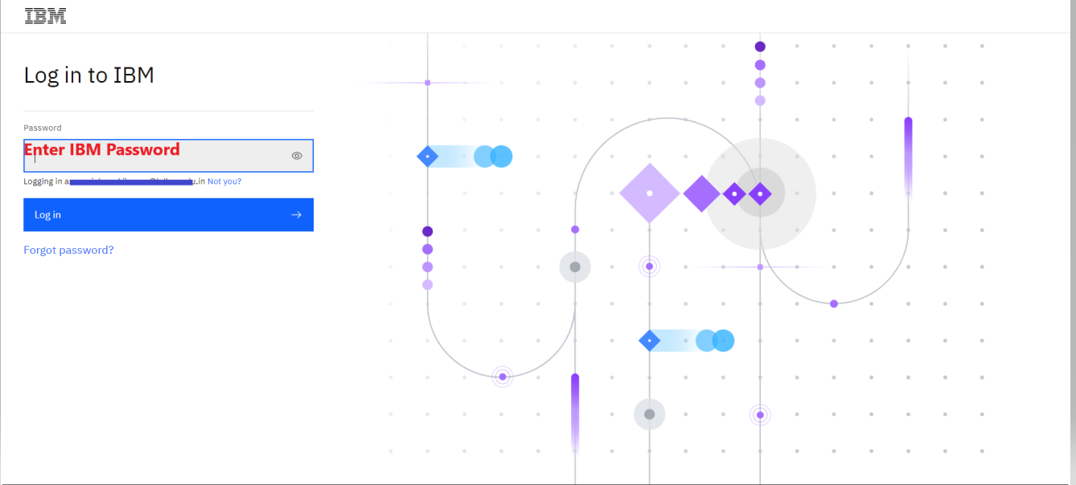

Slide 33
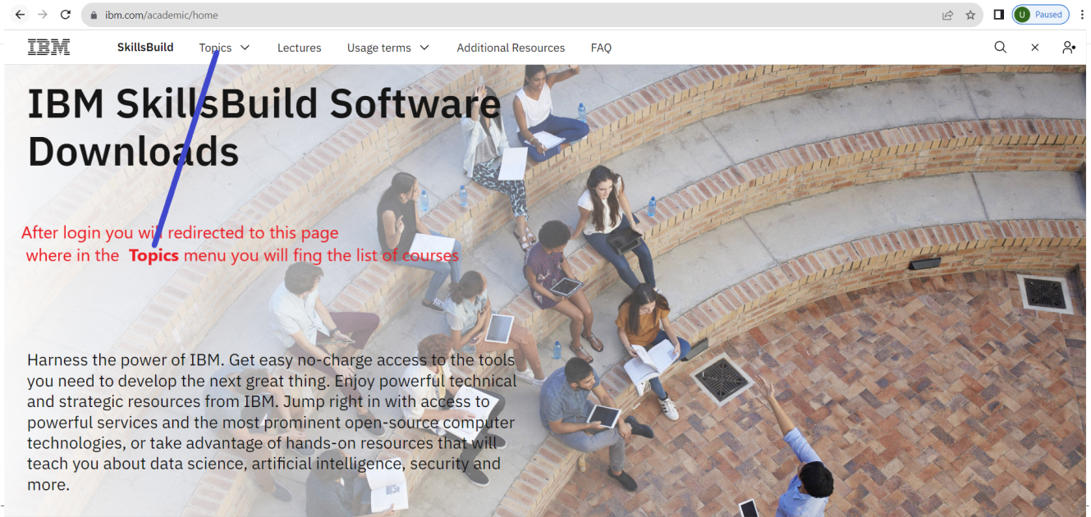

Slide 34
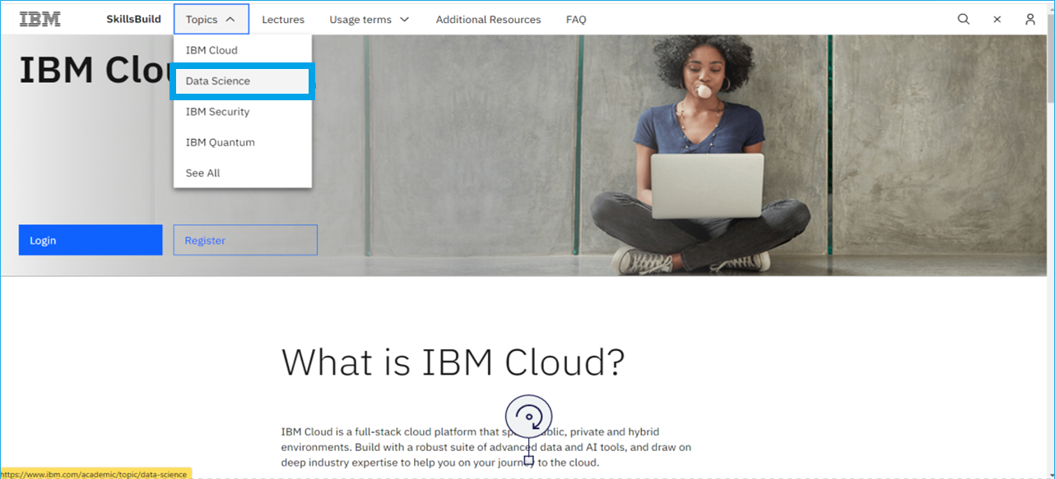

Slide 35
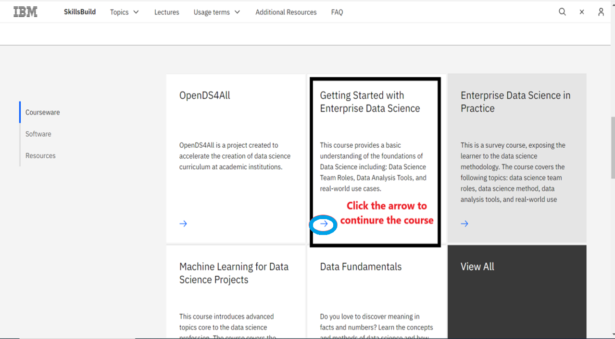

Slide 36
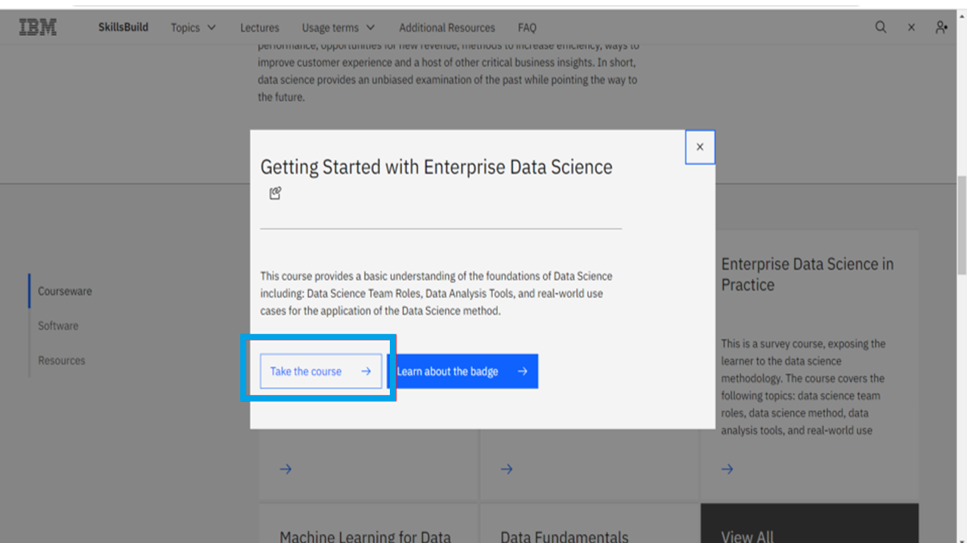

Slide 37
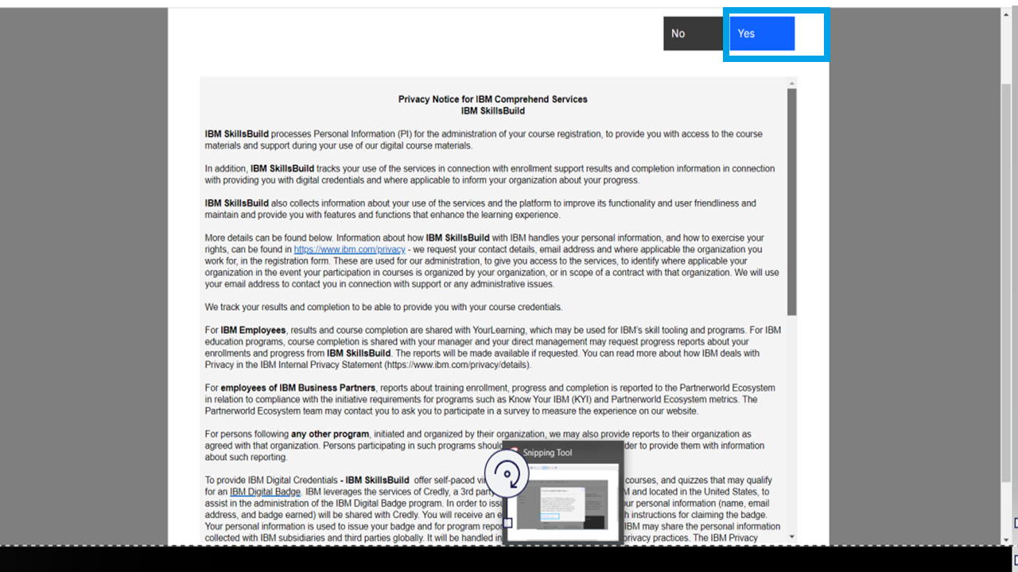

Slide 38
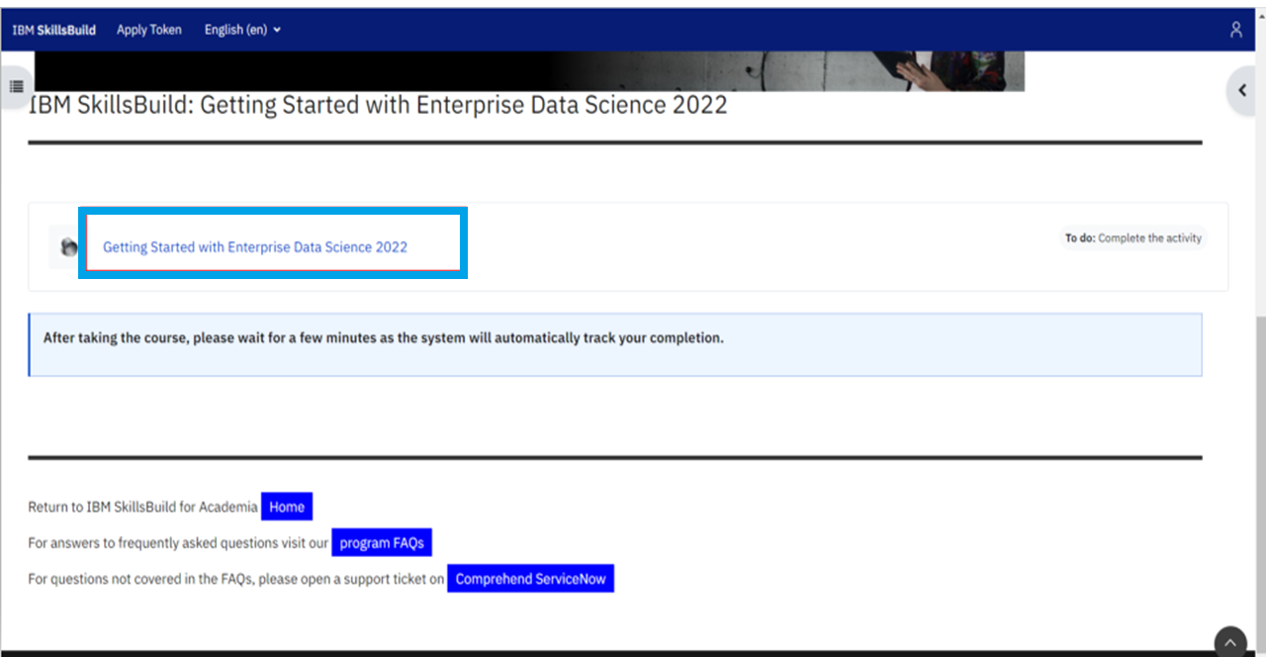

Slide 39
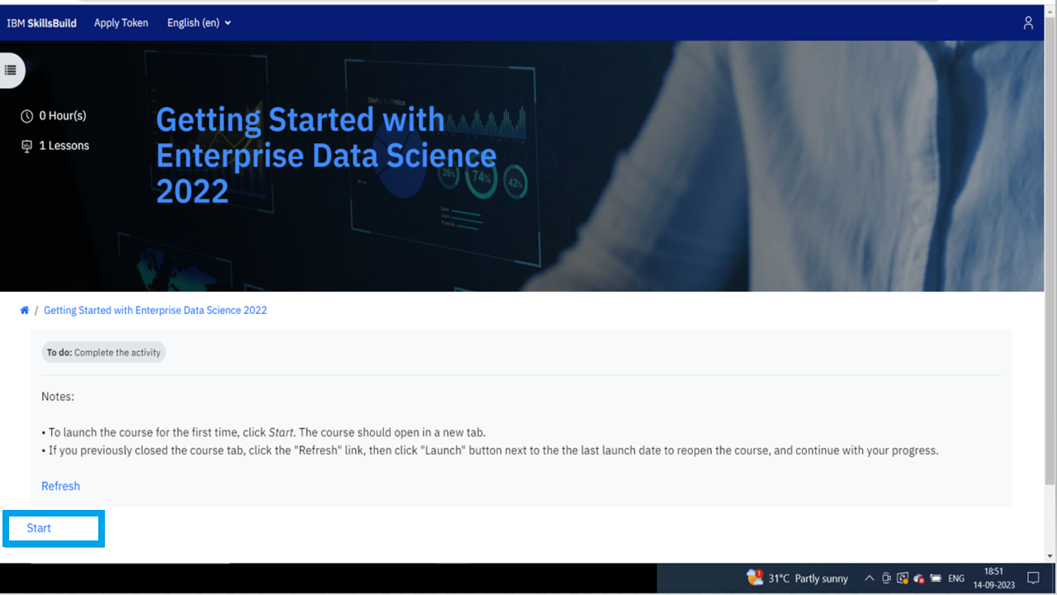

Slide 40
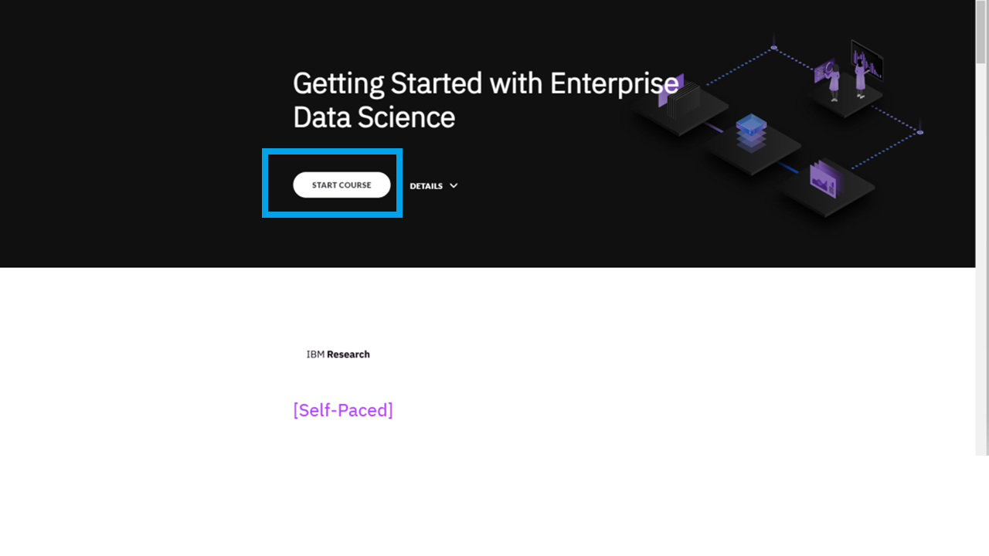

Slide 41
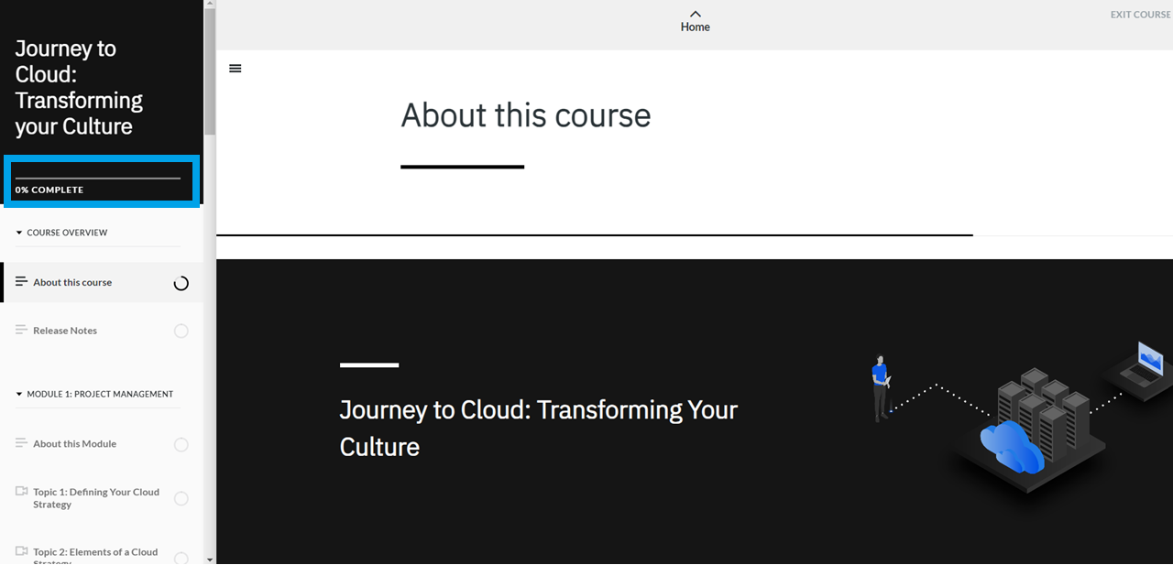

Slide 42
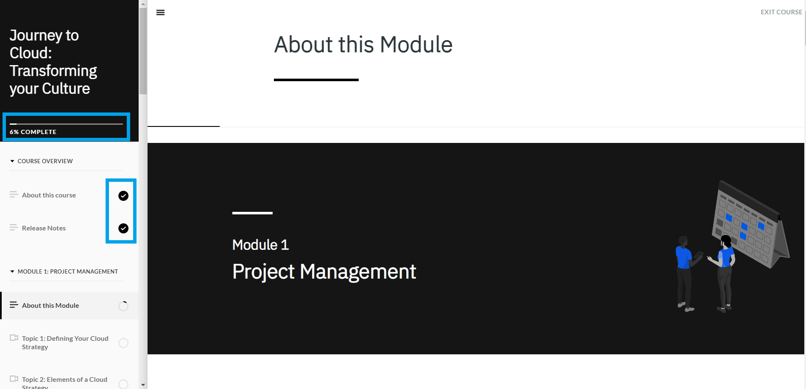

Slide 43
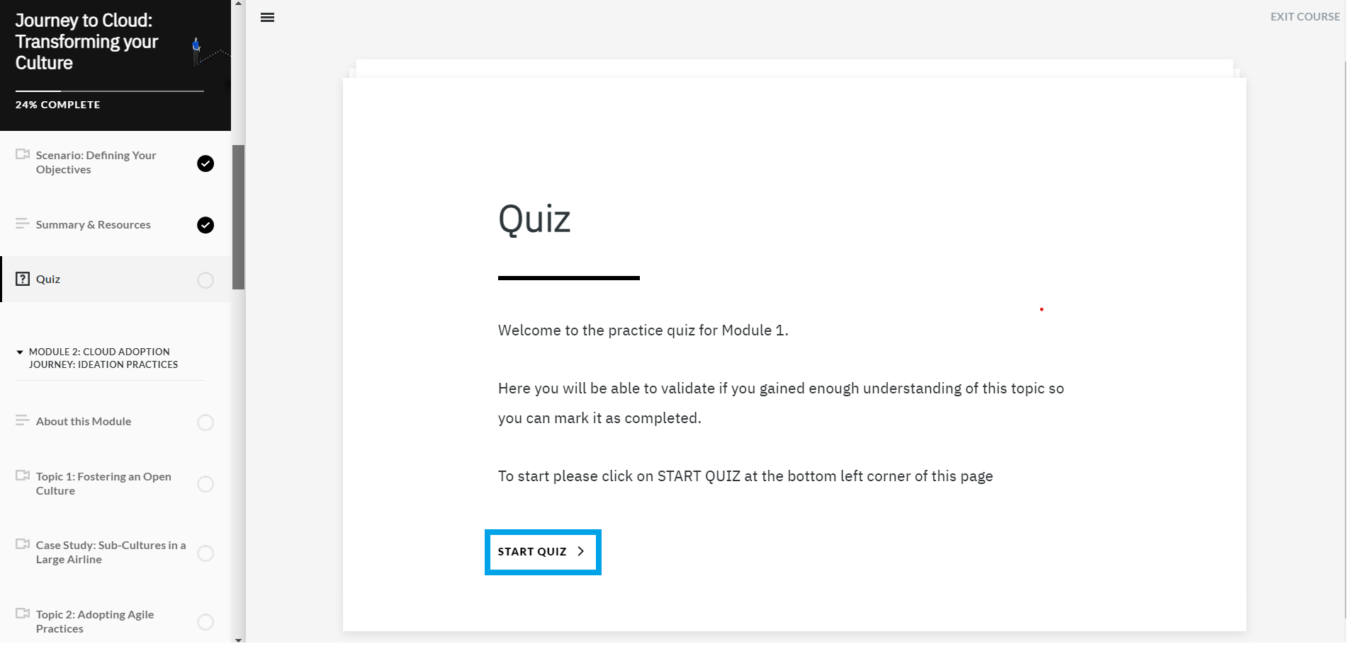

Slide 44
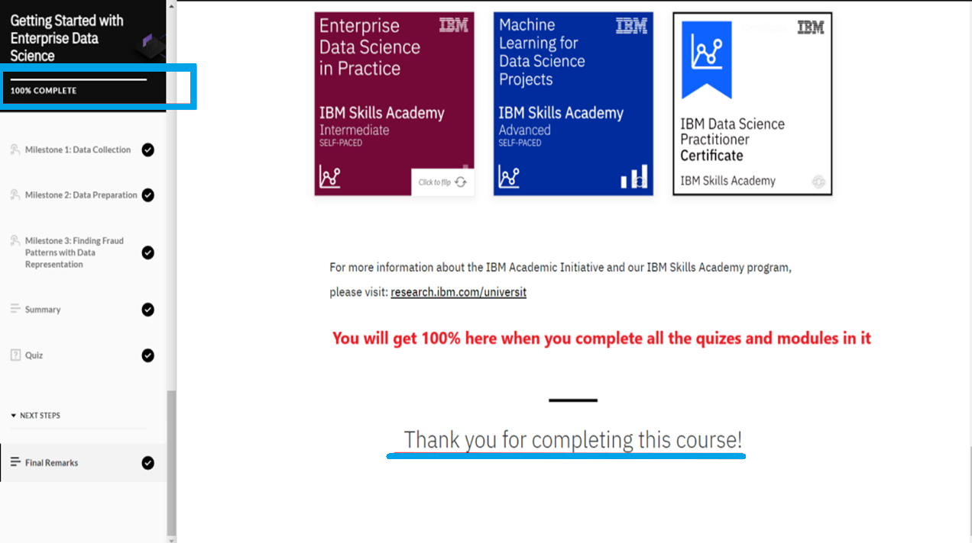

Slide 45
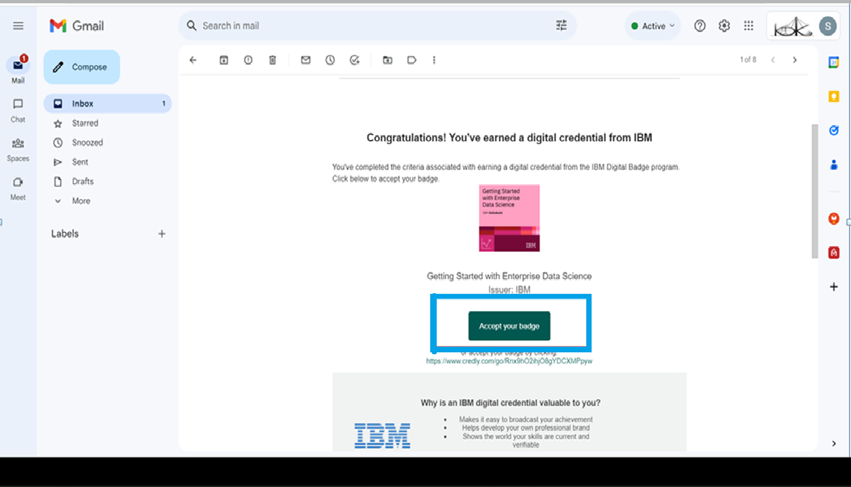
Open Email and click on Accept Badge

Slide 46
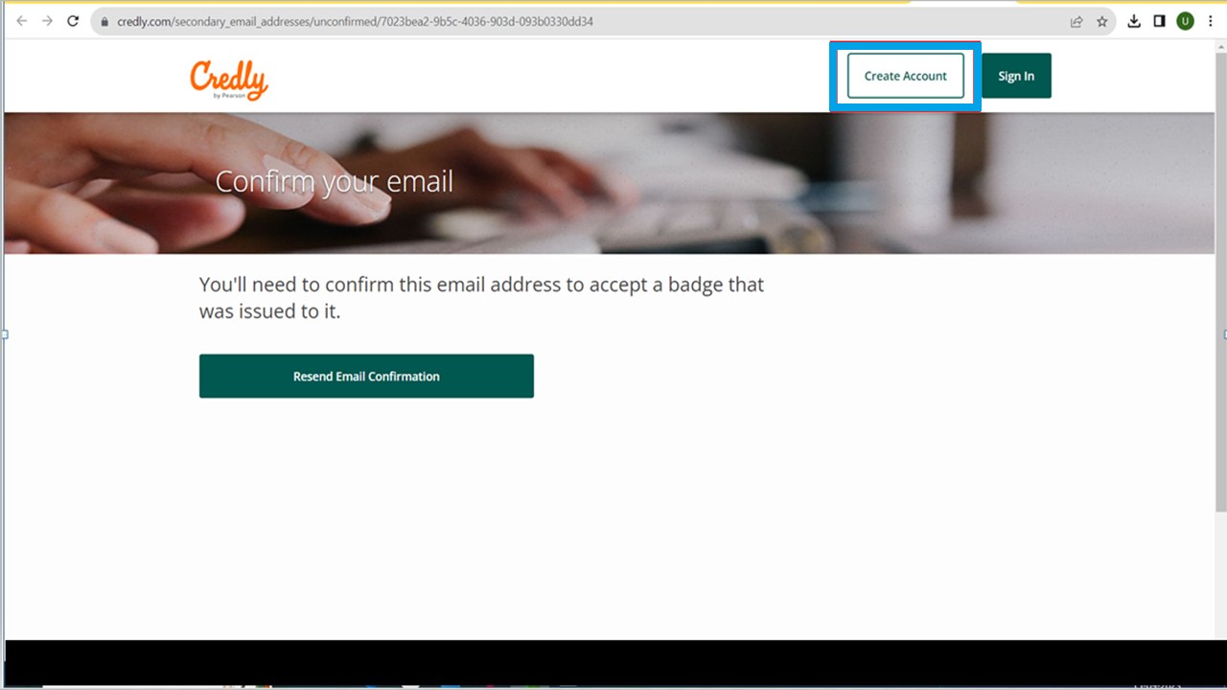
Open Email and click on Accept Badge
If you have credly account click on login else click to create an account

Slide 47
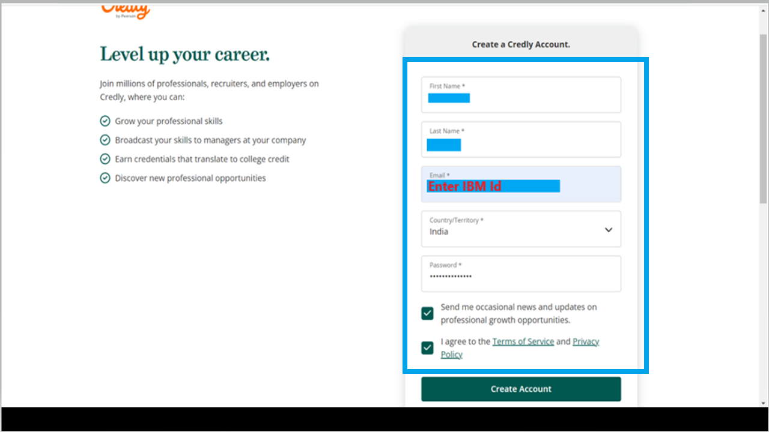
Once entered all the details click create account button

Slide 48
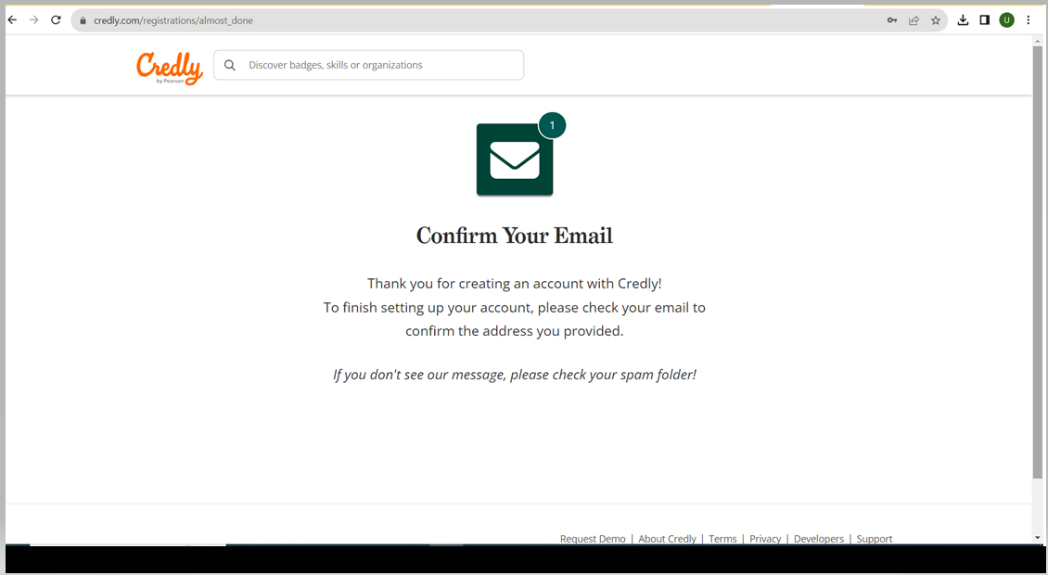
Check your mail to confirm the setting up your account

Slide 49
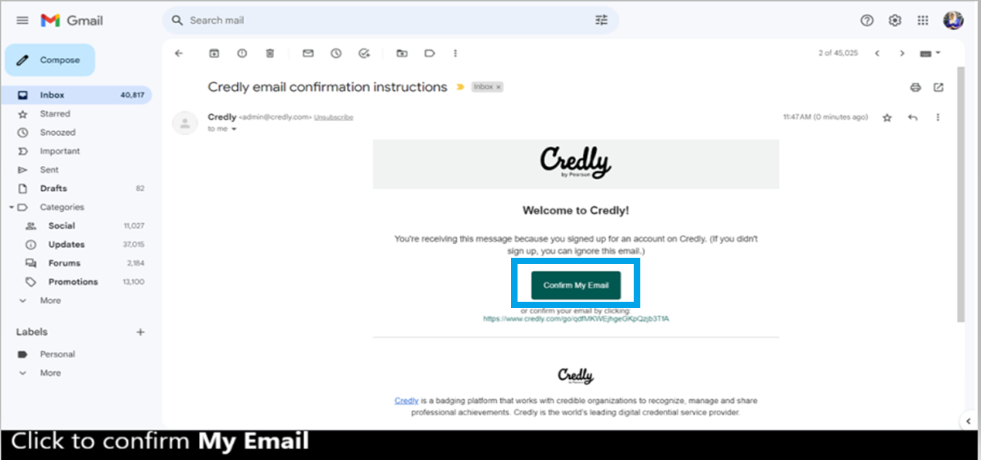

Slide 50
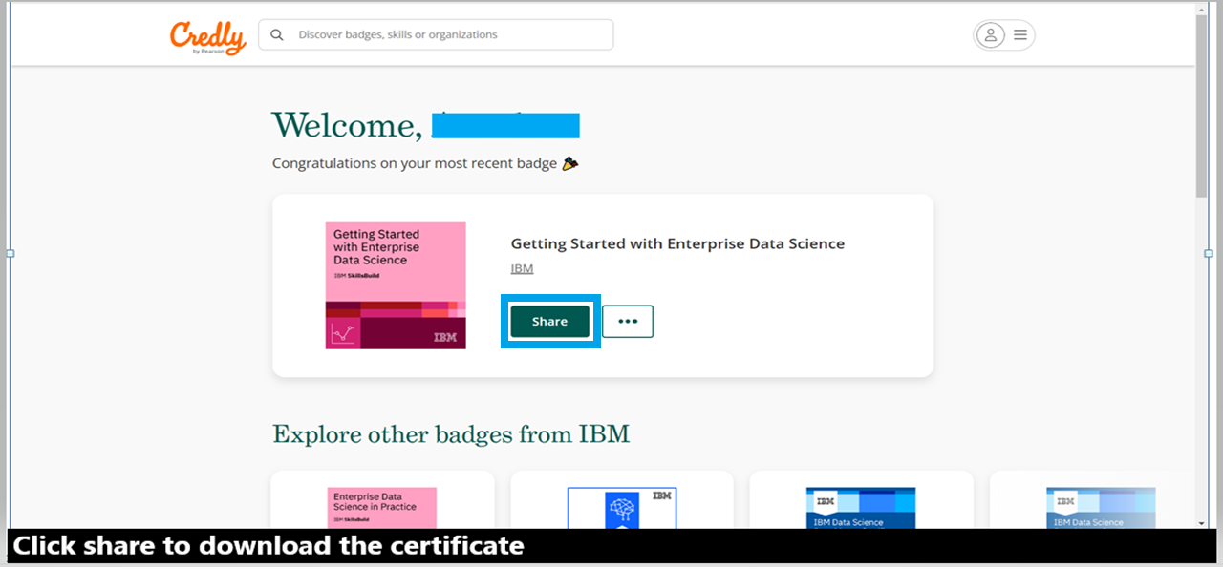

Slide 51
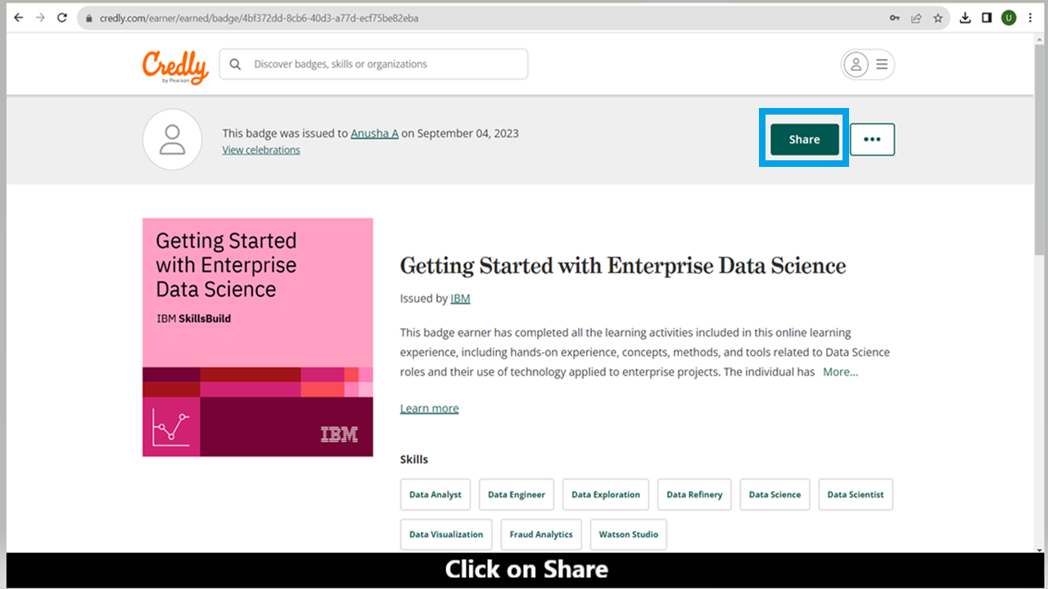

Slide 52
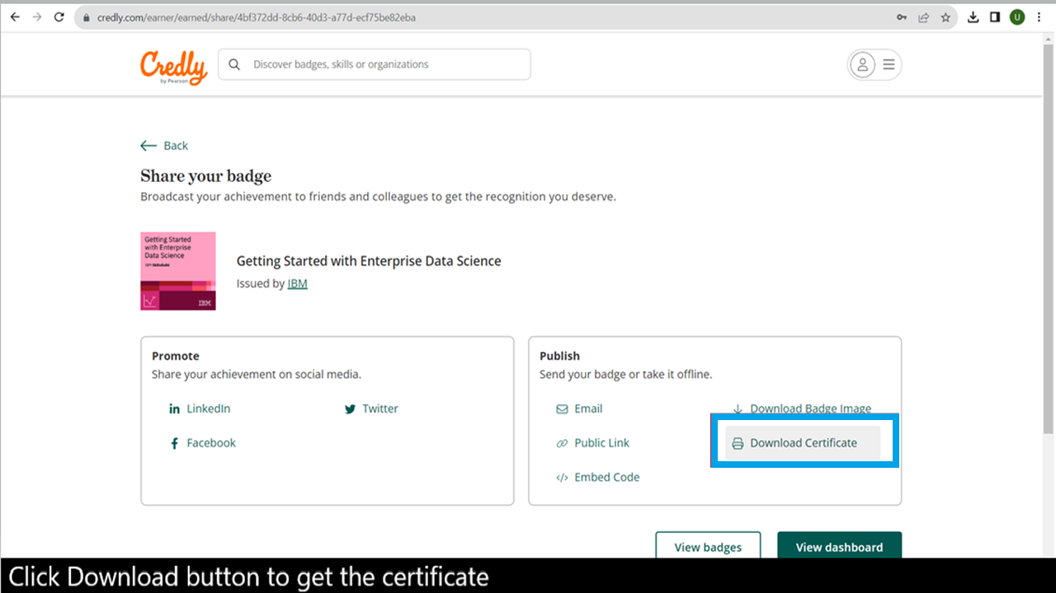

Slide 53
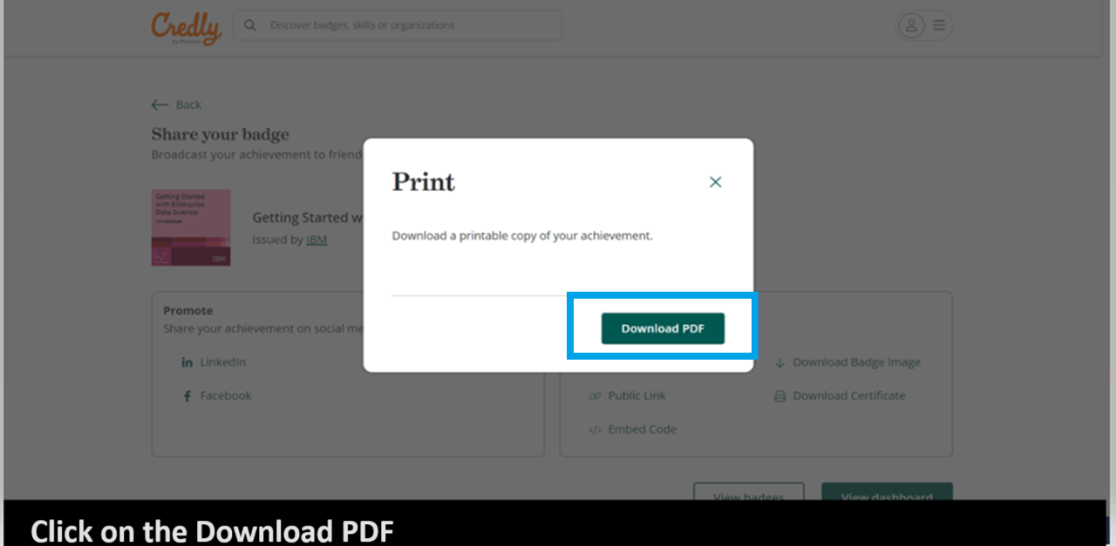

Slide 54
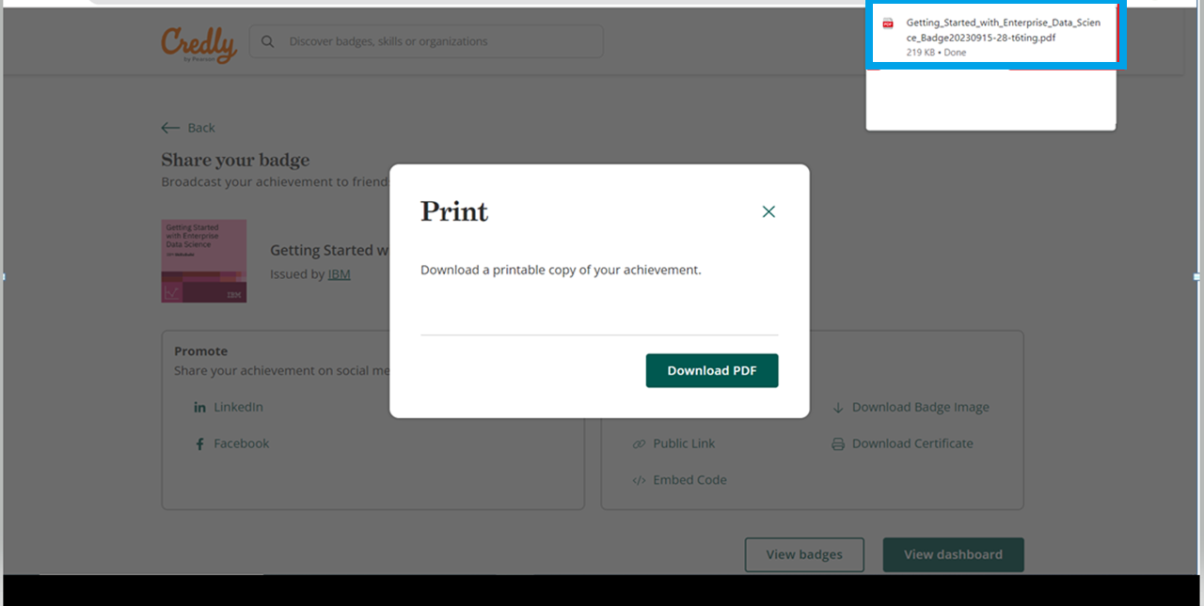
Ones you click on download button it will come in your download section

Slide 55
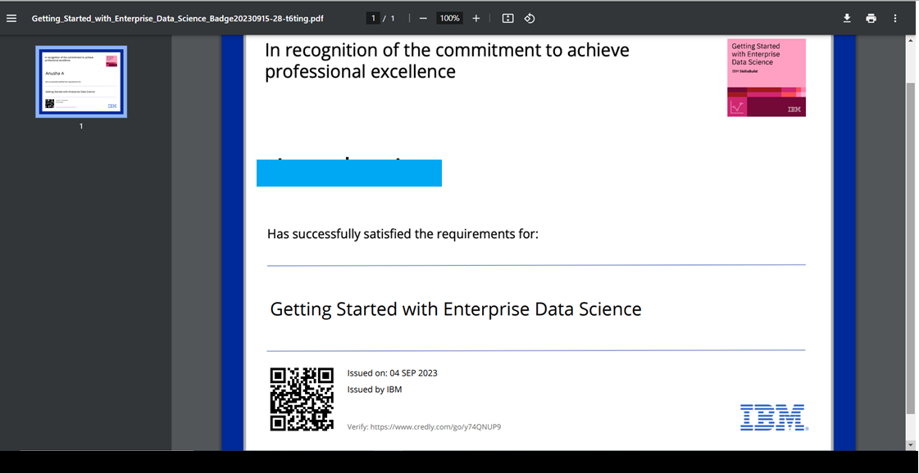

Slide 56
How to Get Feature Code Estimated time: 5 – 10 minutes

Slide 59
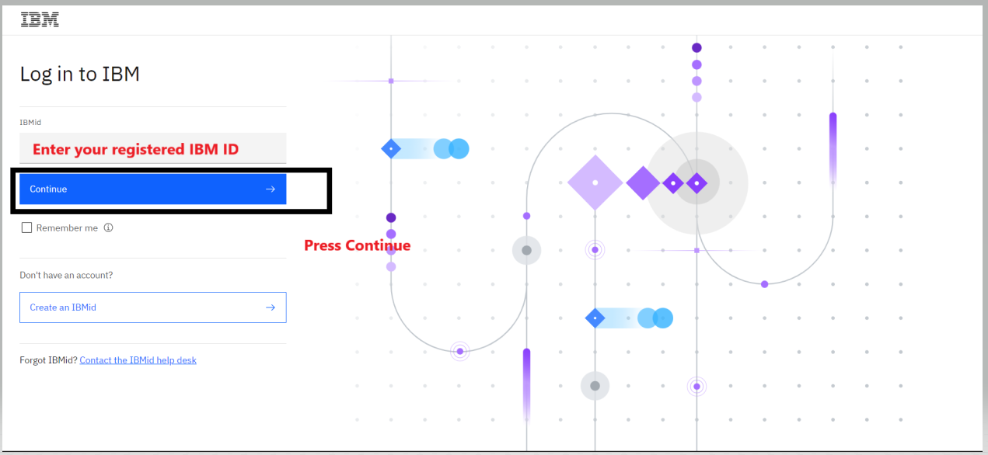

Slide 61


Slide 62
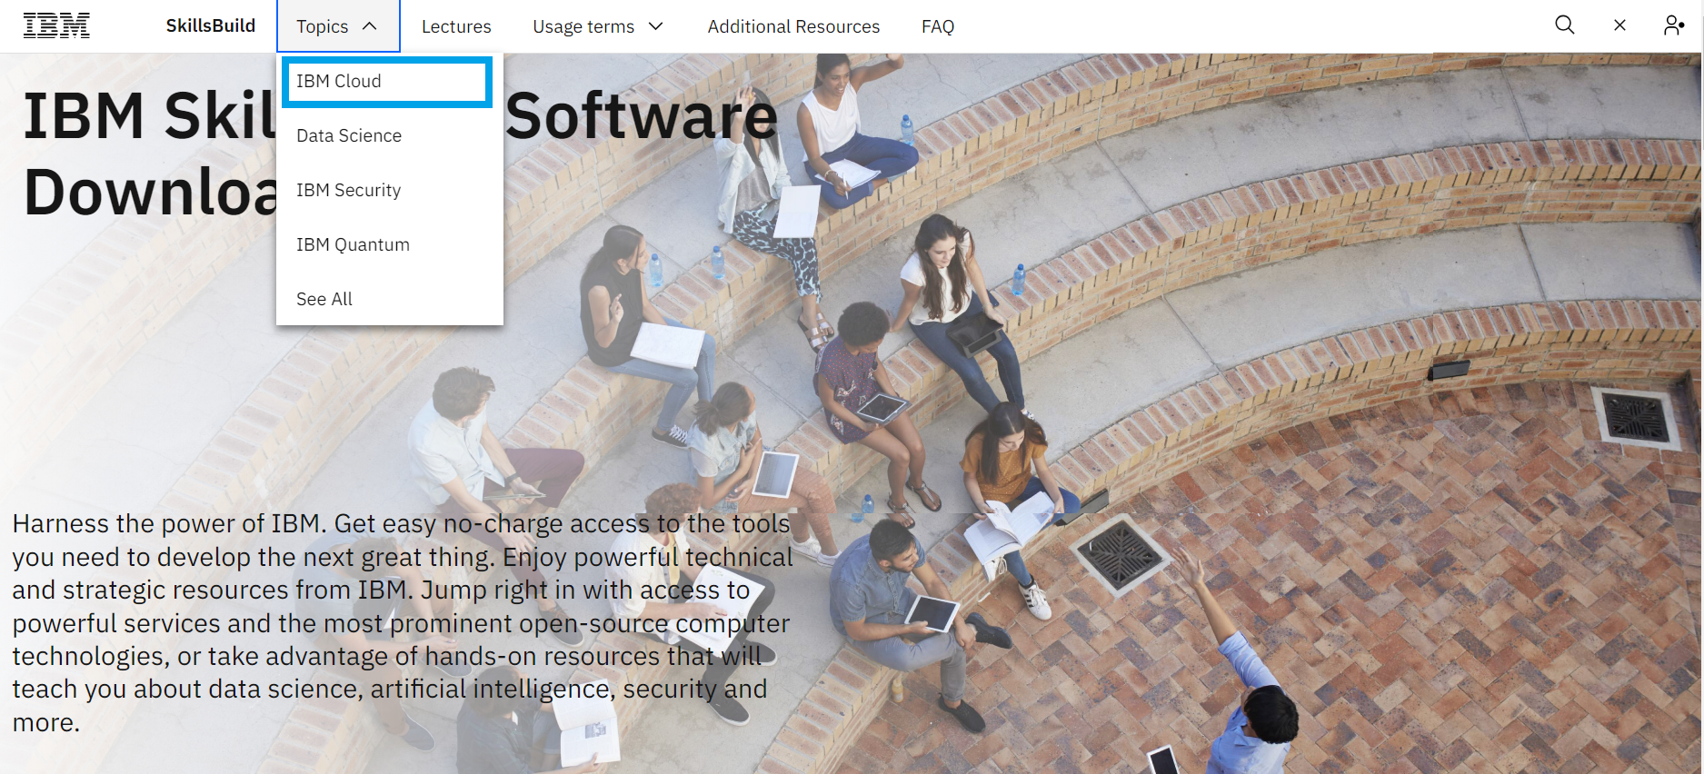

Slide 64
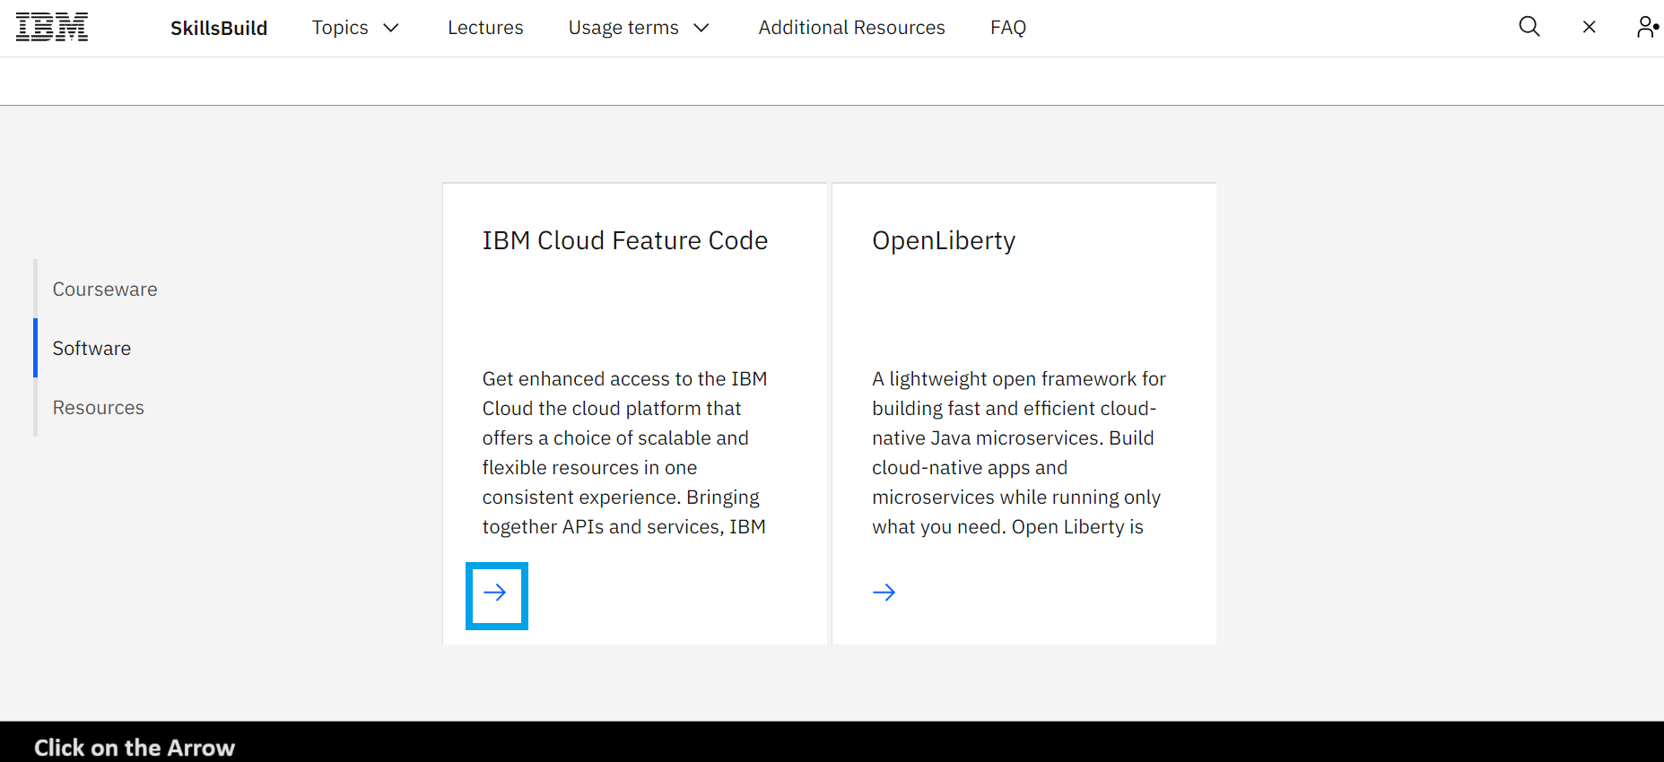

Slide 65


Slide 66


Slide 67


Slide 68
How to Register on IBM Cloud Estimated time: 5 – 10 minutes

Slide 69
https://cloud.ibm.com/registration

Slide 70
Step 1: Visit cloud.ibm.com in a web browser

Slide 71

Step 2: Click on “Create an account”

Slide 72

Step 3: Enter a valid email address. Click “Next” to proceed

Slide 73

Step 4: Enter the 7-digit verification code received in your email. Click “Next” to proceed

Slide 74

Copy the Verification Code

Slide 75

Paste the Copied Verification Code

Slide 76

Step 5:. Click “Continue” to proceed

Slide 77

Step 6: Complete the Account privacy notice and click on “Continue” to proceed

Slide 78

Step 7: Enter IBM ID and press Continue to login to IBM cloud

Slide 79

Step 8: At the Verify identity screen, click on the “Register with a code” option

Slide 80

Step 9: Enter your 32-character IBM Cloud Feature Code in the provided text box. Click “Create account” to proceed

Slide 81

Check the Green tick for successfully applied code

Slide 82

Step 10: Success! Your IBM Cloud account has been created For time being you can skip Survey

Slide 83

Click Manage and then Account to check the validity of feature code

Slide 84

Click on Account Settings

Slide 85

You can see that we can able to access the platform for 395 days and after that you can regenerate the feature code same way

Slide 86
Let’s Begin With your learning Journey

